Slide 1
Evaluating High-Voltage Battery Performance in the BMW i3 (60 Ah)
Group 8
2024/12/17

Slide 2
Project Overview
Objective
Analyze real-world data to predict and optimize battery performance by focusing on:
Environmental factors
Vehicle dynamics
Heating circuit efficiency
Related Variables
Key Features
Environmental Data: Temperature, Elevation
Vehicle Data: Speed, Throttle Position
Heating Circuit Data: Indoor Temp, Heating Power
Target Outcome: Predict the State of Charge (SoC) Difference (Battery Consumption)
Approach
Data Preprocessing: Cleaning and transforming features for modeling
Modeling: Use Linear Models and Tree-Based Models
Performance Comparison: Evaluate models for actionable insights

Slide 3
Model Performance Summary
Linear Models
Linear Regression: Training MSE = 0.0004 | Test MSE = 0.0006 | R² = 0.7768
Lasso Regression: Training MSE = 0.0014 | Test MSE = 0.0003 | R² = 0.8797
Ridge Regression: Training MSE = 0.0005 | Test MSE = 0.0004 | R² = 0.8644
Tree-Based Models
Decision Tree:
Training MSE = 0.0000 | Test MSE = 0.0064 | R² = -0.4816
Feature Importance: Distance [km] = 0.924999
Random Forest:
Training MSE = 0.0002 | Test MSE = 0.0018 | R² = 0.5764
Feature Importance: Distance [km] = 0.816695
Key Insights
Linear Methods clearly outperform tree-based methods: Lower Test MSE (< 0.0006) and higher R² (> 77%)
Data exhibits strong linear relationships between predictors and response
Distance is the most influential feature in both model types, aligning with theoretical expectations

Slide 4
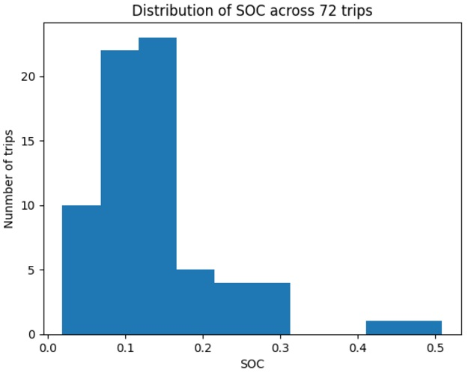
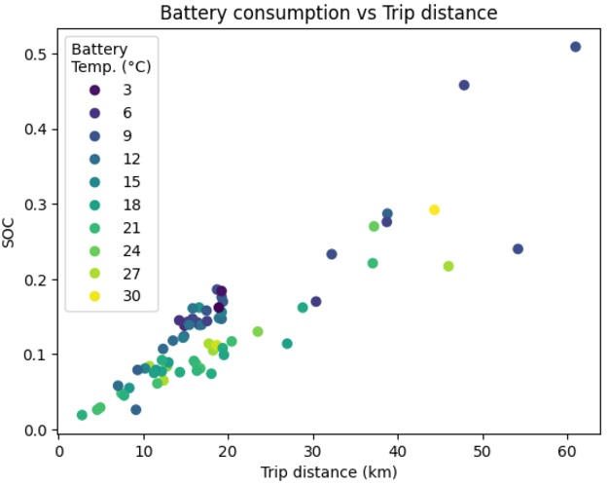
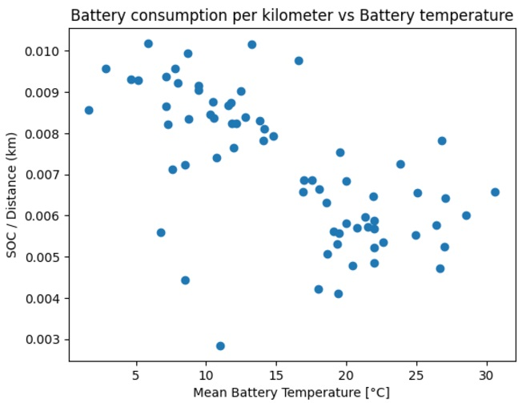
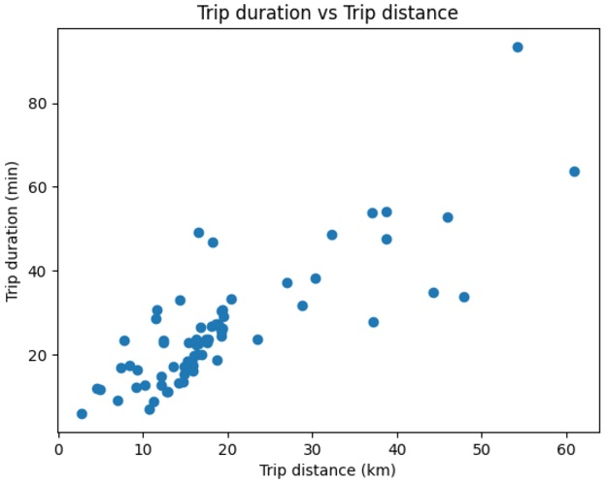
Analysis Results Summary
SOC Variability:
The chart (on the left) shows that the variable of interest, SOC, has significant variations, allowing for a meaningful prediction exercise using the features available in the data.
Distance and SOC Relationship:
The chart (second from the left) demonstrates a linear relationship between distance and battery consumption, with each additional mile requiring a similar amount of energy (SOC/km). This supports the earlier finding that linear models outperform tree-based models, with distance being the most important feature (0.92 feature importance).
Duration's Limited Importance:
The strong correlation between SOC/km and temperature (second from the right) confirms that temperature and distance are key predictors of SOC. Trip duration (on the right) has minimal importance (0.02) due to its high correlation with distance, which already captures most of the SOC relationship (>0.92 importance).

Slide 5
Acknowledgment of Team Members - Group 8
Daniel I Lin
UID: 121033345
Email: dlin0315@umd.edu
Hao-Lin Chiang
UID: 121166357
Email: beas28@umd.edu
Yang-Shun Lin
UID: 121287762
Email: yslin227@umd.edu
Sheng-Hsiang Huang
UID: 121303554
Email: shhuang@umd.edu
Alexios C Papazoglou
UID: 121332967
Email: apapazog@umd.edu
Kai-Wei Hsu
UID: 121366191
Email: kwhsu@umd.edu
Thank you for your attention!
Group 8 - University of Maryland

